Slide 1

DEPARTMENT OF COMPUTER SCIENCE AND ENGINEERING BITCOIN ATTACK PREDICTION USING MACHINE LEARNING
GUIDE:
MR.A.ANBUMANI
(Assistant professor)
TEAM MEMBERS:
GEETH AKSHAY KUMAR M (113319104022)
SANJAY M (113319104073)
THIYAGARAJAN P G (113319104093)
SHAIK ABDUL ALEEM (113319104078)

Slide 2
ABSTRACT
Ransomware attacks are emerging as a major source of malware intrusion in recent times.
Many ransomware prediction techniques are proposed but there is a need for more suitable ransomware prediction techniques for machine learning techniques.
This paper presents an attack of ransomware prediction technique that uses for extracting information features in Artificial Intelligence and Machine Learning algorithms for predicting ransomware attacks.
Variable identification and data understanding is the main process of building a successful model.
Different machine learning algorithms are applied to the pre-processed data and the accuracy is compared to see which algorithm performed better

Slide 3
EXISTING SYSTEM
Ransomware attacks are among the most disruptive cyber threats, causing significant financial losses while impacting productivity, accessibility, and reputation.
In this work, we propose a dynamic analysis approach for attributing ransomware samples based on their pre-attack paranoia activities.
To this end, we draw-upon more than 3K samples from recent/prominent ransomware families to fingerprint their uniquely leveraged paranoia activities
We execute more than 3,000 ransomware samples that belong to 5 predominant families in a sandboxing environment to collect their behavioral characteristics/features in terms of 23 selected pre-attack evasion API calls that are associated with sensing the execution environment.

Slide 4
DISADVANTAGES
They did not mentioning what kind of ransomware attacks they are predicting.
Voting Classifier is not implemented.
Deployment is not done.

Slide 5
PROPOSED SYSTEM
The proposed system is to build a model able to predict the types of ransomware attacks.
The process starts with variable identification like dependent and independent variables where we find the target column.
Then the pre-processing techniques are applied to deal with missing values the pre-processed data is then used to build a model by dividing the dataset into 7:3 ratios where 70% of the data is used for training purposes that are model learns the pattern and the remaining 30% testing data is used to test the performance of our project.
The classification model can be used to predict the bitcoin heist ransomware attack types.

Slide 6
ADVANTAGES
We are implementing particularly on bitcoin ransomware attacks.
We are implementing the voting classifier.
Deployment can be done.

Slide 7
LITERATURE REVIEW
Title : BitcoinHeist: Topological Data Analysis for Ransomware Detection on the Bitcoin Blockchain
Author: Yitao Li , Cuneyt Gurcan Akcora , Yulia R. Gel, Murat Kantarcioglu
Year : 2019
Ransomware is a type of malware that infects a victim’s data and resources, and demands ransom to release them. In two main types, ransomware can lock access to resources or encrypt their content. In addition to computer systems, ransomware can also infect IoT and mobile devices [23]. Ransomware can be delivered via email attachments or web based vulnerabilities. More recently, ransomware have been delivered via mass exploits. For example, CryptoLocker used Gameover ZeuS botnet to spread through spam emails. Once the ransomware is installed, it communicates with a command and control center. Although earlier ransomware used hard-coded IPs and domain names, newer variants may use anonymity networks, such as TOR, to reach a hidden command and control server Once resources are locked or encrypted, the ransomware displays a message that asks a certain amount of bitcoins to be sent to a bitcoin address. This amount may depend on the number and size of the encrypted resources. After payment, a decryption tool is delivered to the victim. However, in some cases, such as with WannaCry, the ransomware contained a bug that made it impossible to identify who paid a ransomware amount.

Slide 8
LITERATURE REVIEW
Title :The BitcoinHeist: Classification of ransomware crime families
Author:Y. A. Azzam, M. I. Nouh, A. A. Shaker
Tracing cryptocurrencies payments due to malicious activity and criminal transactions is a complicated process. Therefore, the need to identify these transactions and label them is crucial to categorize them as legitimate digital currency trade and exchange or malicious activity operations. Machine learning techniques are utilized to train the machine to recognize specific transactions and trace them back to malicious transactions or benign ones. I propose to work on the Bitcoin Heist data set to classify the different malicious transactions. The different transactions features are analyzed to predict a classifier label among the classifiers that have been identified as ransomware or associated with malicious activity. I use decision tree classifiers and ensemble learning to implement a random forest classifier.

Slide 9
LITERATURE REVIEW
Title: A Survey on Detection and Classification of Ransomware Bitcoin Transactions
Author:Sabira Karim, Shemitha PA
Year : 2021
Bitcoin might be a suburbanized form of payment system wherever the general public ledger is correctly supported in a very distributed manner. The unknown anonymous members referred to as miners, capital punishment a protocol that maintains and extends a distributed public ledger that records bitcoin transactions is termed a block chain. Block chain is enforced as a series of blocks. Bitcoin is that the known crypto-currency business. The transactions of bitcoin area unit utterly digital and unknown to a good extent. This case has crystal rectifier several cyber-crime perpetuators to use bitcoin as a secure haven for misbr transactions like Ransomware payments. Ransomware is malicious code that affects the payments entry reciprocally of ransom that should be paid

Slide 10
LITERATURE REVIEW
Title: Predictive Analysis of Ransomware Attacks using Context-aware AI in IoT Systems
Author:Vytarani Mathane, P.V. Lakshmi
Year : 2021
Among all those ransomware attacks could be more impacting owing to attack methodology where victim systems become unusable until a ransom is paid, typically have attacker-defined timelines to respond, and can cause more monetary loss. Ransomware attacks, one of the malware attacks affect all types of security issues availability which causes monetary losses, and sensitive information loss . Crypto ransomware, locker ransomware, and hybrid ransomware are common types of ransomware.In crypto-ransomware attacks, data files are encrypted and the decryption key is provided only after paying the ransom. In locker ransomware attacks, the resources are blocked and are released only after paying the ransom. In hybrid ransomware attacks, both concepts of crypto ransomware and locker ransomware are used.

Slide 11
ENVIRONMENTAL REQUIREMENTS
SOFTWARE REQUIREMENTS:
Operating System : Windows 10 or later
Tool : Anaconda with Jupyter Notebook
HARDWARE REQUIREMENTS:
Processor : Intel i3
Hard disk : minimum 10 GB
RAM : minimum 4 GB

Slide 12
LIST OF MODULES
Data Pre-processing
Data Analysis of Visualization
Logistic Regression
Voting classifier
Random Forest Classifier
XG boost classifier
Deployment

Slide 13
DATA PRE-PROCESSING
Validation techniques in machine learning are used to get the error rate of the Machine Learning (ML) model, which can be considered as close to the true error rate of the dataset.
If the data volume is large enough to be representative of the population, you may not need the validation techniques.
To work with samples of data that may not be a true representative of the population of given dataset.
To finding the missing value, duplicate value and description of data type whether it is float variable or integer.

Slide 14
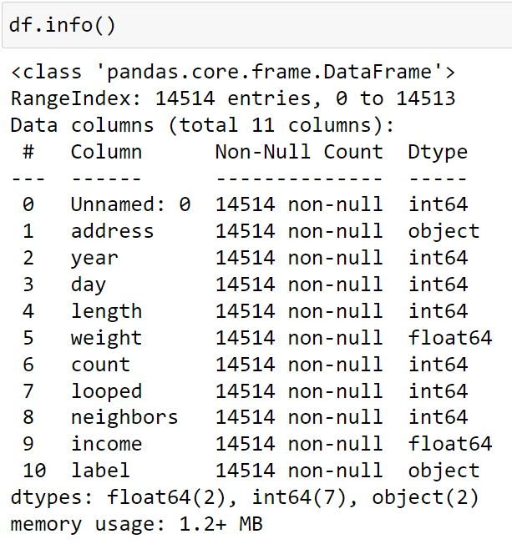
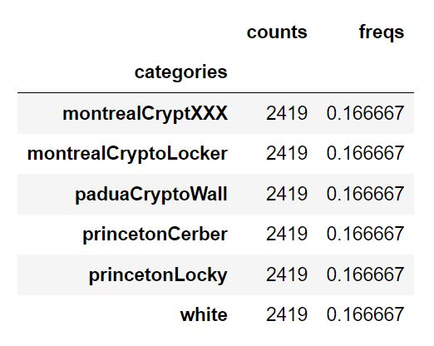
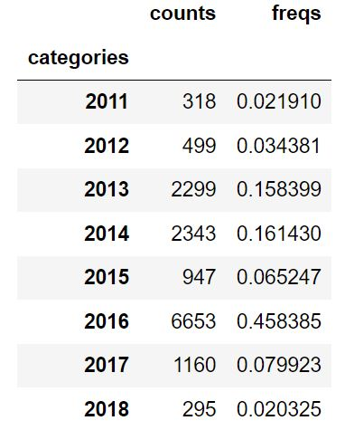
DATA PRE-PROCESSING - SAMPLE

Slide 15
DATA VISUALIZATION
Data visualization is an important skill in applied statistics and machine learning.
Statistics does indeed focus on quantitative descriptions and estimations of data.
Data visualization provides an important suite of tools for gaining a qualitative understanding.
This can be helpful when exploring and getting to know a dataset and can help with identifying patterns, corrupt data, outliers, and much more.
Data visualization and exploratory data analysis are whole fields themselves and it will recommend a deeper dive into some the books mentioned at the end.

Slide 16
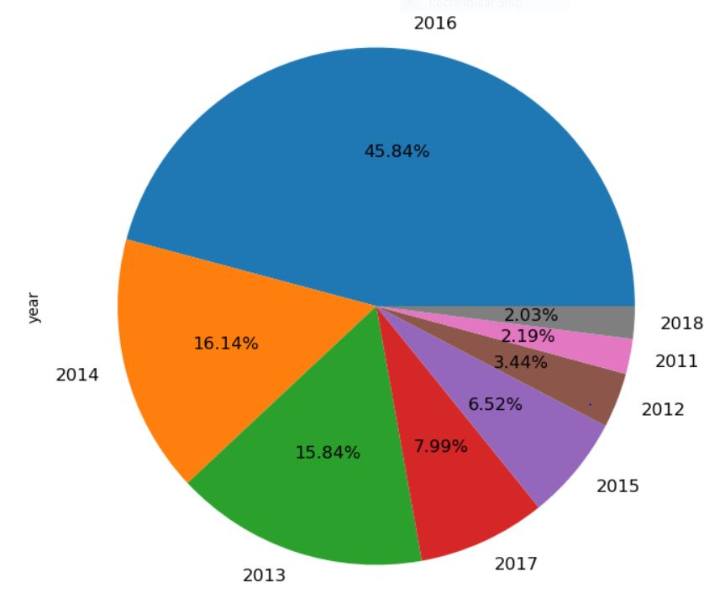
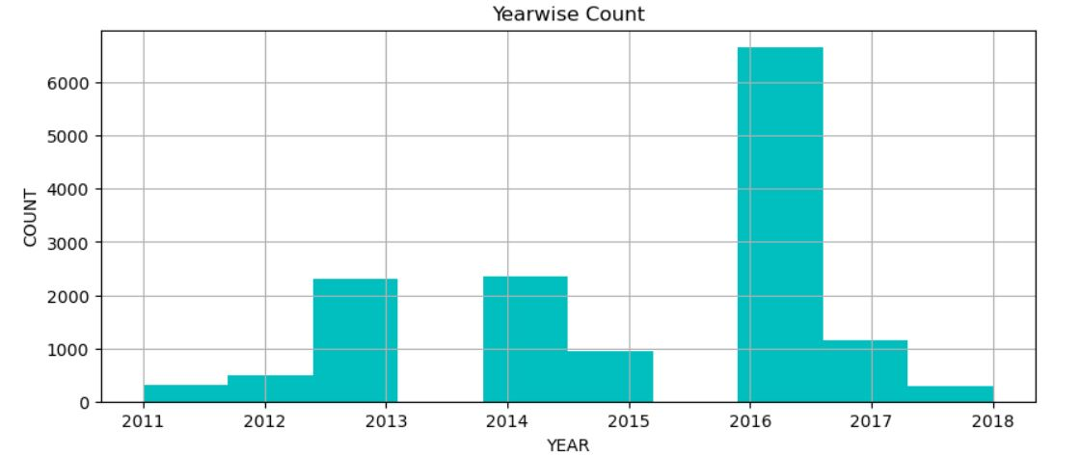
DATA VISUALIZATION - SAMPLE

Slide 17
LOGISTIC REGRESSION
Logistic regression is another powerful supervised ML algorithm used for binary classification problems.
The best way to think about logistic regression is that it is a linear regression but for classification problems.
Logistic regression essentially uses a logistic function defined below to model a binary output variable.
The primary difference between linear regression and logistic regression is that logistic regression's range is bounded between 0 and 1.
In addition, as opposed to linear regression, logistic regression does not require a linear relationship between inputs and output variables.

Slide 18
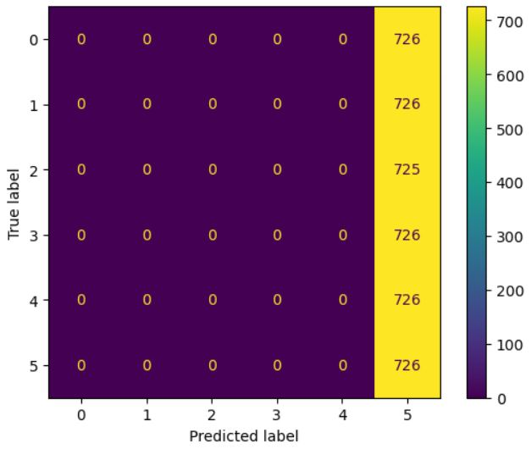
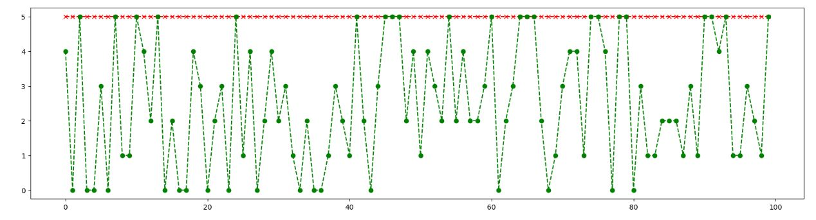
LOGISTIC REGRESSION- SAMPLE

Slide 19
RANDOM FOREST CLASSIFIER
Random Forest is a popular machine learning algorithm that belongs to the supervised learning technique. It can be used for both Classification and Regression problems in ML.
It is based on the concept of ensemble learning, which is a process of combining multiple classifiers to solve a complex problem and to improve the performance of the model.
Random Forest is a classifier that contains a number of decision trees on various subsets of the given dataset and takes the average to improve the predictive accuracy of that dataset.
The greater number of trees in the forest leads to higher accuracy and prevents the problem of overfitting.

Slide 20
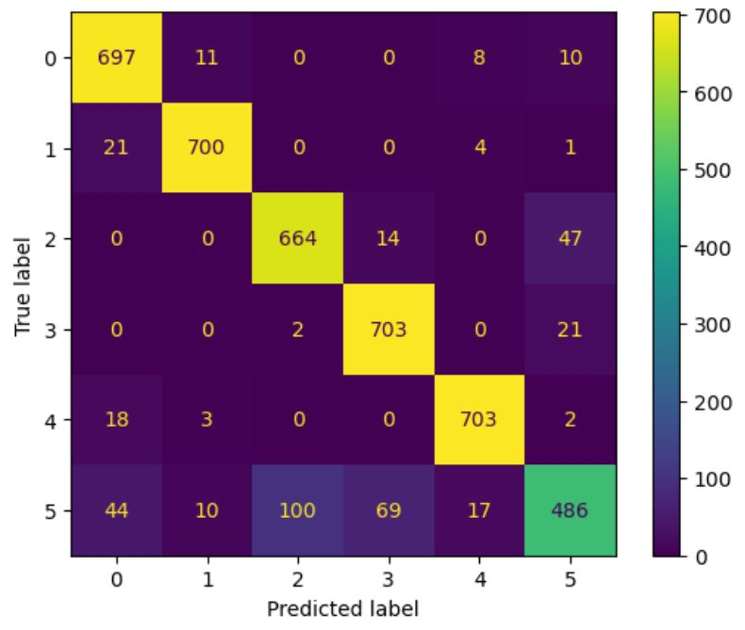
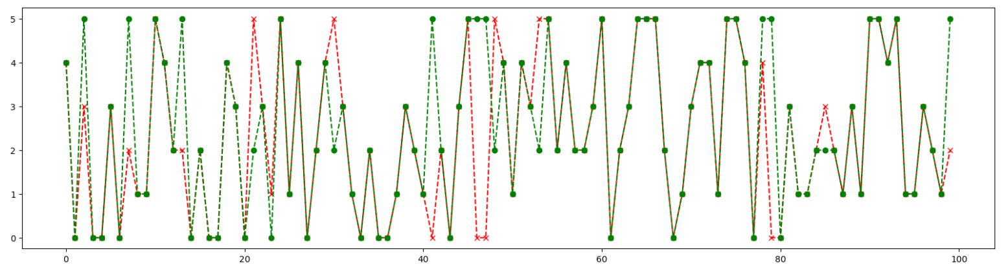
RANDOM FOREST CLASSIFIER - SAMPLE

Slide 21
XG BOOST CLASSIFIER
Its speed and performance are unparalleled and it consistently outperforms any other algorithms aimed at supervised learning tasks.
The library is parallelizable which means the core algorithm can run on clusters of GPUs or even across a network of computers.
This makes it feasible to solve ML tasks by training on hundreds of millions of training examples with high performance.

Slide 22
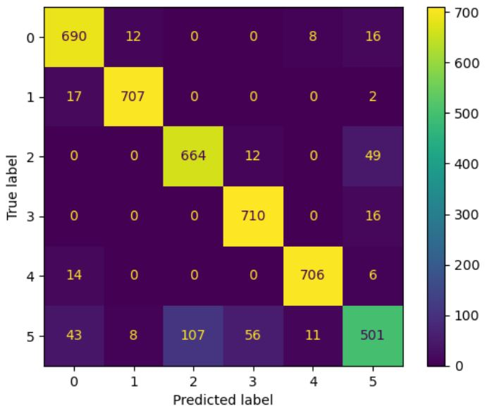
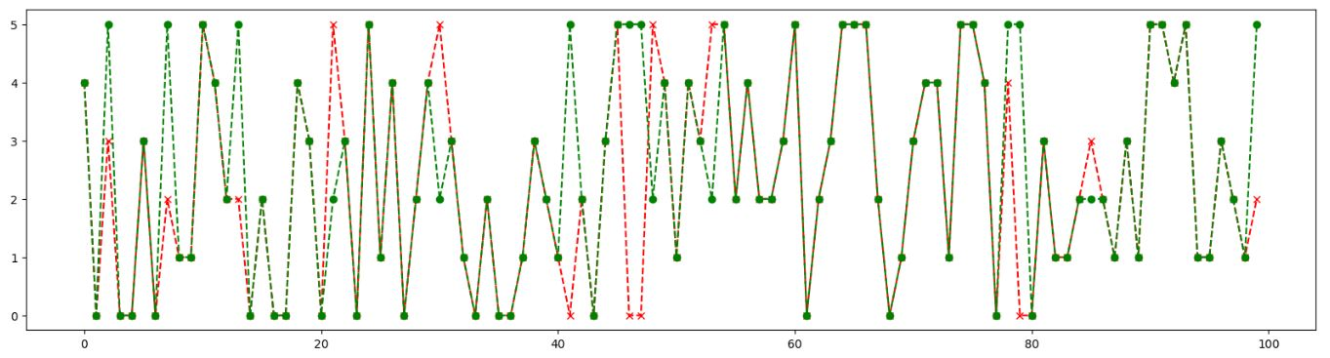
XG BOOST CLASSIFIER - SAMPLE

Slide 23
VOTING CLASSIFIER
A Voting Classifier is a machine learning model that trains on an ensemble of numerous models and predicts an output (class) based on their highest probability of chosen class as the output.
It simply aggregates the findings of each classifier passed into Voting Classifier and predicts the output class based on the highest majority of voting.
The idea is instead of creating separate dedicated models and finding the accuracy for each them, we create a single model which trains by these models and predicts output based on their combined majority of voting for each output class.

Slide 24
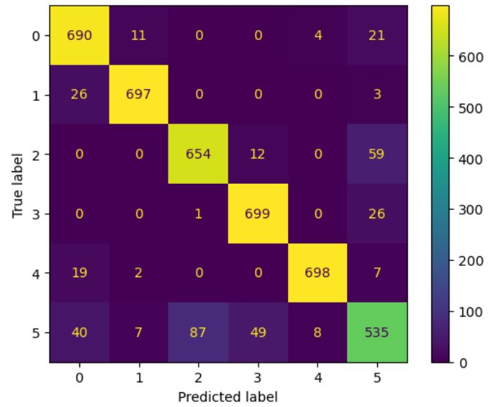
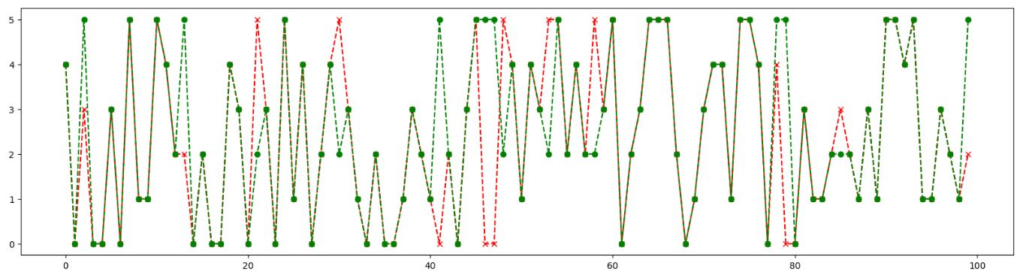
VOTING CLASSIFIER - SAMPLE

Slide 25
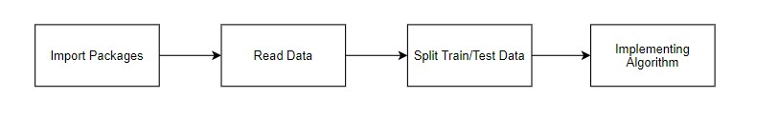
DEPLOYMENT
In this module the trained machine learning module is implemented with a user interface.
EXPECTED OUTPUT:
INPUT: DATA
OUTPUT: GETTING ACCURACY

Slide 26

DEPLOYMENT - SAMPLE

Slide 27
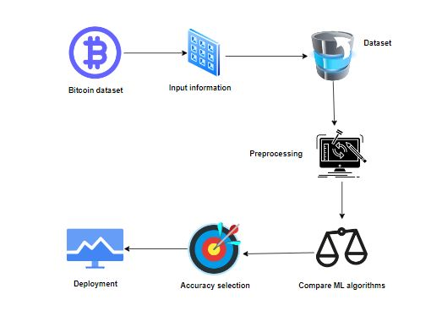
SYSTEM ARCHITECTURE

Slide 28
FUTURE WORK
Deploying the project in the cloud.
To optimize the work to implement in the IOT system.

Slide 29
CONCLUSION
The analytical process started from data cleaning and processing, missing value, exploratory analysis and finally model building and evaluation.
The best accuracy on public test set of higher accuracy score algorithm will be find the Bitcoin Heist randsomeware.

Slide 30
REFERENCES
Muniye, Temesgen & Rout, Minakhi & Mohanty, Lipika & Satapathy, Suresh. (2020). Bitcoin Price Prediction and Analysis Using Deep Learning Models. 10.1007/978-981-15-5397-4_63.
Al Harrack, Micheline, The BitcoinHeist: Classifications of Ransomware Crime Families (October 2021). International Journal of Computer Science & Information Technology (IJCSIT) Vol 13, No 5, October 2021.
Çağlar, Ersin & Kirikkaleli, Dervis. (2020). The Crypto-currency and Cyber-attack: Evidence from Causality Techniques. International Journal of Engineering Trends and Technology. 68. 1-4. 10.14445/22315381/IJETT-V68I9P201.
Mahajan, Rahul & Roychaudhary, Reema. (2021). Protective Mechanism form DDoS Attack for Cryptocoin. 12. 1421.
Shah, Naman & Dave, Sonal. (2022). Review on Types of Attacks on Bitcoin and Ethereum crypto currencies. International Journal of Engineering Research in Computer Science and Engineering. 9. 1-6. 10.36647/IJERCSE/09.10.Art001.

Slide 31
THANK YOU

